Slide 1
Process and Thread Synchronisation Concepts
The Sleeping Barbers Problem
Note: Examples of the concepts presented here can be found in the RTExamples folder: Q11
You are encouraged to open the project(s) in Visual Studio and run the program(s)
©Paul Davies 2020. Not to be copied, used, or revised without explicit written permission from the copyright owner. This lecture may contain animations and is best viewed as a slide show

Slide 2
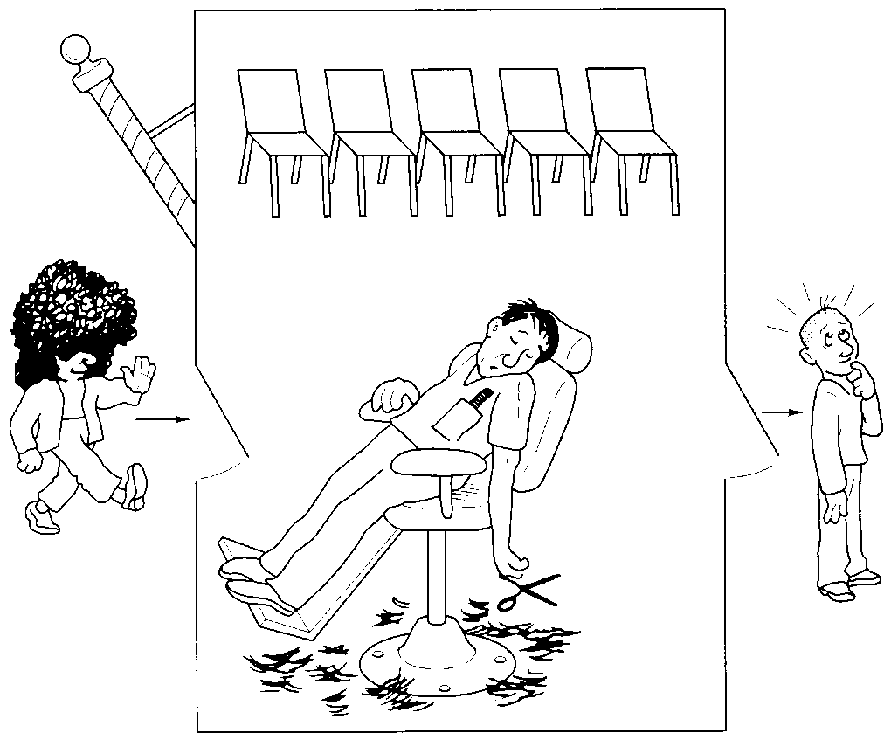
The Sleeping Barber Problem
‘The Sleeping Barbers’ problem is a classic process/thread synchronisation problem that appears in all books on Operating systems and Concurrent Programming. Basically the description of the problem goes like this
There is a single barber (i.e. a thread) with a single chair (i.e. the non sharable resource) where customers sit to have their hair cut. (This basic scheme can be extended to include several barbers/chairs)
There also exist other chairs where customers can sit and wait while the barber is busy, i.e. a queue
When a barber arrives for work, he opens his shop and because, initially at least, there are no customers, he goes to sleep in his chair as there is nothing for him to do.
Throughout the day, customers (other threads that have to wait for the barber) arrive and if the barber is asleep they will wake him up to get a haircut, after which, if no further customers are waiting, he will go back to sleep.
However because the frequency and timing of the arrival of customers is not predictable by the barber (he doesn’t use a booking system!!), a customer could arrive while the barber is cutting someone’s hair, in which case the customer will take a seat and wait.
However, if all seats are occupied, the customer will walk away in disgust.
See http://en.wikipedia.org/wiki/Sleeping_barber_problem

Slide 3
The Sleeping Barber Problem (cont…)
The reason this problem is a classic is that this situation mirrors many other real-world, day-to-day problems encountered in Banks, Post offices, Gas stations and telephone call centres where customers queue up to use some service or resource and may find themselves put on hold, i.e. they have to wait
In these real situations, the services or resources are the staff that work there (or Gas pumps in the case of gas stations), just like our barber that cuts hair.
From a computing and synchronisation point of view, think of customers and the barber as being processes/threads wishing to synchronise to share a resource such as a print spooler or a web-server or petrol pump.
The solution to this kind of problem must address a number of issues.
  Make sure an orderly, first-in, first-out queue is maintained, i.e. customers gain access to the resource in the order they request it. This guarantees deterministic response time and eliminates the possibility of indefinite lock-out or starvation.
  If a resource is busy then the processes/threads waiting to use it should enter an idle state that doesn’t waste CPU time.
  If the resource is idle then it should not waste CPU time if there are no processes/threads wishing to make use of it (i.e. the barber, Gas station pump etc which should go to sleep).
  If there is more than one idle resource that can satisfy the request for service then customers should not have to be kept waiting.
  Finally it is desirable (though no essential) to keep the number of customers leaving in disgust to a minimum, think of lost internet sales if the web-server is too busy to deal with the volume of transactions. The solution to this is to include a bigger queue or throw more resources at the problem (duplicate servers for example – i.e. more barbers)

Slide 4
A Basic Outline of Sleeping Barbers Synchronisation Class
class CSleepingBarbers {
CSemaphore Customers; // counting semaphore records num of customers waiting for hair cut (set to 0)
CSemaphore Barbers ; // counting semaphore records num of barbers actively cutting hair (set to 0)
int NumberOfWaitingCustomers // keeps a record of the number of occupied seats (=0)
int NumberOfAvailableChairs // keeps a count of the fixed number of resources. // (Defined by user, say 6)
// This function is called by the Barber when he is free. He will go to sleep if no one wants him
void BarberWaitsForCustomer() {
Customers.Wait() ; // barber thread will sleep unless customers sat in chairs waiting
--NumberOfWaitingCustomers ; // decrement the number of waiting customers
. . . // cut the customers hair here
Barbers.Signal() ; // wake up next customer for hair cut
}
// This function is called by a customer when they want a hair cut. It returns TRUE if customer got serviced
// or FALSE if they left in disgust.
BOOL CustomerWaitsForBarber() {
if(NumberOfWaitingCustomers < NumberOfChairs) { // if there is a spare seat, sit on it or leave
++(NumberOfWaitingCustomers) ; // record new customer waiting
Customers. Signal() ; // wake up the barber if he is asleep
Barbers. Wait() ; // Wait for Barber to cut this customers hair
return TRUE ; // customer will get haircut
}
else
return FALSE ; // leave in disgust
}
} ;
See rt.h for full code

Slide 5
An example of the use of this class can be seen below.
An example can also be found in question 11 in the tutorial guide, which you can download from the web page and load into visual studio C++
// Create a Barber shop with two chairs in waiting room, (minimum is 1 otherwise everyone leaves in disgust)
CSleepingBarbers b1("JimsBarberShop", 2) ;
//
// This active class represents a customer thread
//
class Customer : public ActiveClass
{
public: Customer() { } // constructor doesn't do anything in this example
private:
int main(void)
{
for (int i = 0; i < 10; i++) // simulate 10 haircuts over a time period
{
cout << "Customer Arriving.....\n";
if (b1.CustomerWaitsForBarber() == FALSE) // if FALSE returned then leave in disgust
cout << "Not Enough Chairs....Left in Disgust\n";
SLEEP(3000); // allow hair to grow again (3 Seconds) !!!!
}
return 0; // terminate thread
}
};
A Sleeping Barbers object to synchronise barbers and customers

Slide 6
//
// This thread represent a Barber
//
class Barber : public ActiveClass
{
public:Barber() { } // constructor doesn't do anything here
int main(void)
{
while (1) {
b1.BarberWaitsForCustomer(); // wait for my next customer
cout << ".....Serving Customer.....\n";
SLEEP(1500); // simulate time for cutting hair = 15Sec
}
return 0; // terminate thread
}
};

Slide 7
Here is the main driver program which creates two Barber Threads (adjust to suit) and then Some Customer threads at random intervals
int main()
{
const int NumBarbers = 2;
const int NumCustomers = 10 ;
Barber theBarbers[NumBarbers] ; // an array of 2 barbers all suspended
Customer theCustomers[NumCustomers]; // an array of 10 customers all suspended
//create 9 customers with suitable delays in between to simulate the random arrival of customers
// 1st three customer arrive as soon as the barbers shop opens
theBarbers[0].Resume() ;
theBarbers[1].Resume() ;
theCustomers[0].Resume() ;
theCustomers[1].Resume() ;
theCustomers[2].Resume() ;
theCustomers[3].Resume() ;
SLEEP(1000) ;
theCustomers[4].Resume() ;
theCustomers[5].Resume() ;
// then a rush of 4 customer after work closes
SLEEP(1000) ;
theCustomers[6].Resume() ;
theCustomers[7].Resume() ;
theCustomers[8].Resume() ;
theCustomers[9].Resume() ;
for(int i = 0; i < NumCustomers; i ++)
theCustomers[i].WaitForThread() ;
theBarbers[0].WaitForThread() ;
theBarbers[1].WaitForThread() ;
return 0 ;
}

